Slide 1
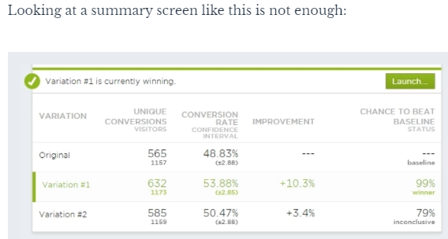
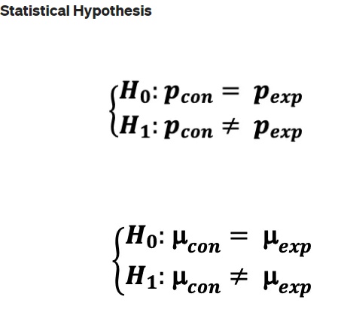
A/B Tests
A series of A/B tests can rapidly lead to an optimized design
If huge sample sizes then even small, effects can be reliably detected and have high impacts
Run test long enough to achieve statistical signficance
Avoids costs of recruiting participants since they don’t even know they are the subjects of an experiment + no need to get ethical approval to use them as guinea pigs
Often consider ATE (average treatment effect)
If want to do cohort-level analysis will need larger sample
May not find stat significance at pop level but do within cohorts
Lift =
(Treatment Conversion Rate – Control Conversion Rate )/ Control Conversion Rate
Considerations
Novelty effect – consumer behaviour changes initially before regressing to before i.e ATE is overestimated
Primary effect - reluctant to change behaviour now but might be more interested in later stages i.e. ATE underestimated
See also Causation Analysis / Difference in Difference Analysis (DiD) / RDD (Regression discontinuity design)
Use Case Types
Design related
Site page
Wording of text
Model related
Impact on KPIs e.g. churn / upgrades / ARPU
Algorithm related
New product / feature launch

Slide 2
Examples
Click through rate (CTR)
Measures usability of site
Conversion rate
Measures actual impact of feature
Improve the quality of the recommender system’s recommendations
adding Impression Discounting
decrease the score of a recommendation every time you propose it, making sure that one recommendation (even if it will constantly be considered as the best one by the personalization solution) will not appear over and over on your screen.
building a Re-ranker model for the recommender
XGBoost can be used as a re-ranker model to rerank RecSys recommendations

Slide 3
Hypothesis
A/B test should always be based on a hypothesis that needs to be tested. This hypothesis is usually set as a result of brainstorming and collaboration of relevant people on the Product team and Data Science team. The idea behind this hypothesis is to decide how to ‘fix’ a potential issue in the product where a solution of these problems will influence the Key Performance Indicators

Slide 4
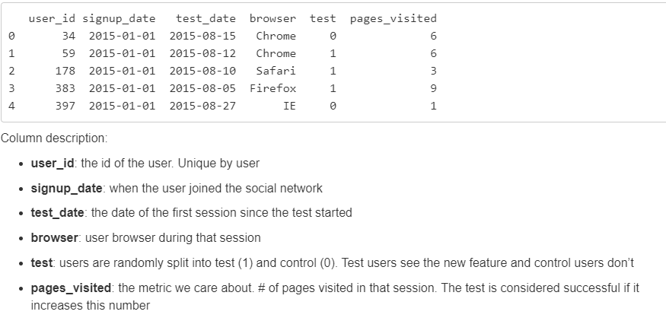
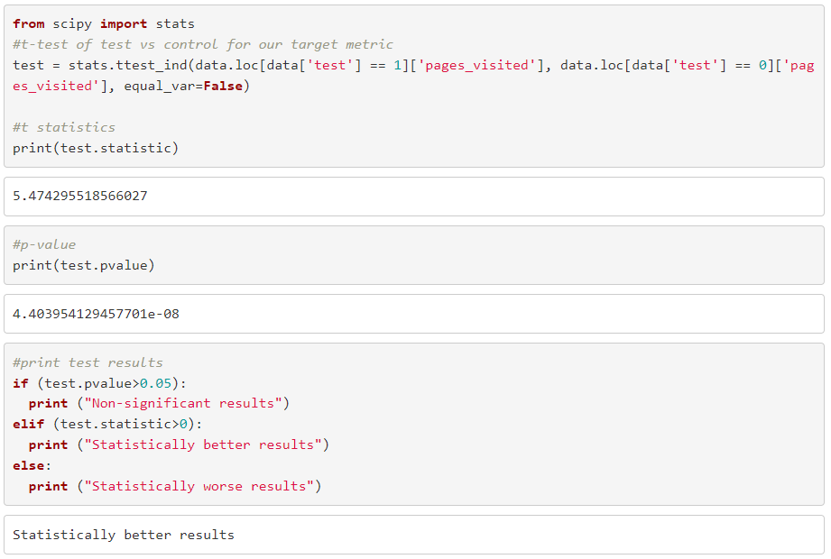
Data Examples
increase in page views is close to 2%, which would mean a massive revenue increase for any medium or large company that makes money with ads.
scipy.stats.ttest_ind
test for the null hypothesis that 2 independent samples have identical average

Slide 5
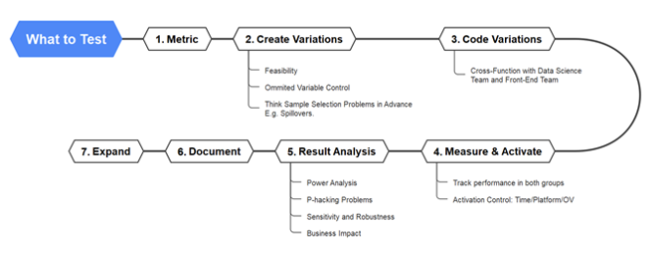
Power Analysis
If I set the power to 0.8 based on empirical literature and the statistical power calculator gives me a sample size of 9 then I can say if I get 9 measurements per group, I will have an 80% chance of correctly rejecting the null hypothesis
“power analysis” involves four interrelated concepts: power, effect size *i.e.minimum detectable effect, sample size and alpha.
Might make alpha bigger if implementation cost of new solution is more expensive, so need bigger effect size to justify
Common to set alpha = 5%, means 20% Type II error and 5% Type I error
Experimental length?
Can depend on traffic / rate of success
Might depend on time of year
T-test analysis
Independent t-test to compare mean of two groups
Pair sample t-test to compare mean of one group before and after treatment
One sample t-test to compare mean to a specific value
Interferences between control and treatment group?
Confounding variables
Sample selection bias
Reverse causality
Omitted variable bias

Slide 6
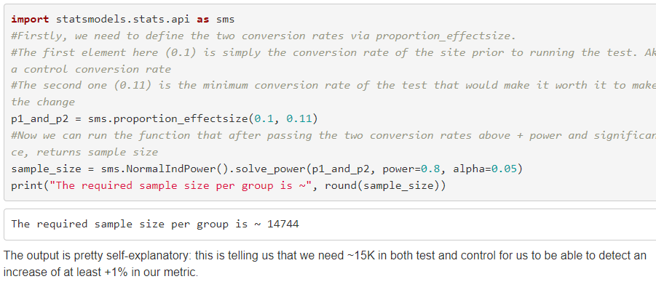
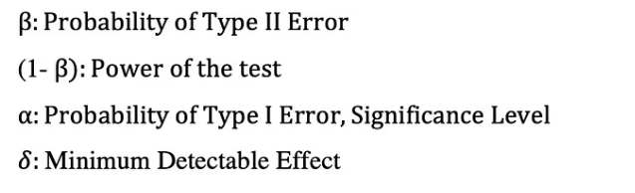
Sample Size Calculation aka Power Analysis
Why? Ensures avoidance of p-hacking and that results can be generalized to population and hold statistical significance
Three main parameters:
Test significance level (alpha, 0.05)
probability of Type I error or False Positive i.e. believe the treatment is better than the old version when it isnt
the lower this is, the better
Test power (0.8) (1-beta i.e. probability of not making a type II error
probability of correctly rejecting the null hypothesis. Power is the probability of making a correct decision (to reject the null hypothesis) when the null hypothesis is false.
probability of correctly saying that the new version is better, when it is indeed better
1-power is the probability of not making the change to the site, while you should have done it (being too conservative essentially). Higher the power the better
Means that we are okay to have 20% probability of not detecting (failing to reject the null) a treatment effect where there is one
Minimum effect you are interested in detecting
if test increases conversion by 0.000001%, probably still won’t make the change, even if that difference were statistically significant
engineering costs, time, and opportunity-cost in general, will make it useless to make a change to get that small of a gain
More of a business than data scientist decision, product manager will have better idea on costs etc.
Sample size increases as significance level decreases, test power increases, min effect size decreases

Slide 7
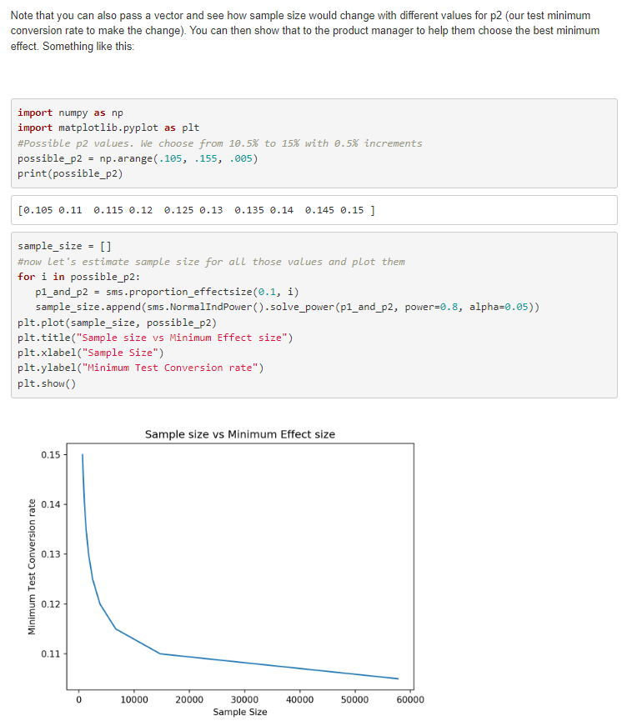
Sample Size continued

Slide 8
Once you know sample size for test & control, determine the length of time to run the trial
Need user traffic predictions
General rule is:
If you need >2 weeks to collect that many people, just split the traffic 50/50 and run it until you have the required sample size
If need <2 weeks (high traffic companies), still advise on running for 2 weeks to reliably capture weekly patterns. Just test it on only a proportion of users to ensure meet required sample size i.e. min disruption to existing approach, maximise capturing of patterns (large companies typically run tests on 1% or less of their users)
Too short & subject to novelty effects / unrepresentative sample
Too long & likelihood of external effects impacting behaviour and possibly contaminating test results is large i.e. maturation effect

Slide 9
Sample Size Estimation
If we make changes to control, the timeline to reach statistical significance will reset. When mitigation is applied it reduces the volume of customers routed through model 0, which could extend time required to be confident in the save rate of model 0
Approach 1: Min sample size needed to ensure the confidence interval of the difference in save rates has width x e.g. ensures that we have a point estimate of 65% (theoretical save rate for the population), with a confidence interval of width W at a confidence level 1-α? Two-sided t-test
Approach 2: Power Analysis Approach –
One sided Proportional T-test
Min sample size needed to test whether our alternative hypothesis, that the effect size of the treatment is statistically significant
Or if wantg cohort analysis, min sample size required for each group to detect a stat significant difference between two proportions
Need:
Power of test (~80%) i.e. proba of detecting a significant difference when one exists
Confidence Level
Effect Size (proportions in treatment and control effectively e.g. 67% save rate in control, 68% in treatment)

Slide 10
Alternative package
!pip install “sample-size>=3.0.0”
From sample_size.sample_size_calculator import SampleSizeCalculator
SampleSizeCalculator(Alpha=0.5, Power=0.8)

Slide 11
Ensuring replication of experiments through
Stored source code
Stored results / data
Detailed methodology
Random seeds

Slide 12
External & Internal Validity
External | Internal
results are generalizable to the entire population - Increase this by ensuring unbiased sample & representative (e.g. weighted / stratified sampling) | results from experiment are valid and reliable vs inaccurate and biased Factors impacting this include Omitted variable bias (this causes change not treatment) Reverse causality …

Slide 13
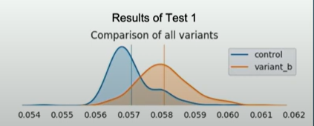
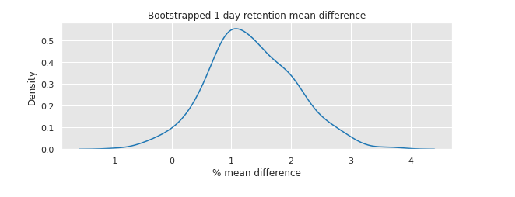
Bootstrapping in AB testings
Resampling 100s or 1000s of times (depending on cost/time) with replacement to create a distribution, helping quantify uncertainty and variability of your statistic (calculates s.e, confidence interval ,p-value) N.B Ideal to parallelise in spark if poss using multithreading – though can be quite expensive
treat your original sample as if it were the population, and draw new samples from it with replacement
it's like replaying your A/B test thousands of times, each with a slightly different audience, to see how stable your results really are
E.G. Take 2000 samples of 10000 users, and get confidence intervals at 95%
Can then say the 95% CI for treatment effect was 14% - 17% → since this is far from 0 can be certain there is a significant impact
For each sample can either work out mean statistic for each and plot (top image), or work out mean diff between each sample between control & test & plot (see below image)
A way to estimate distribution i.e. uncertainty (a poor man’s Bayes, non informative prior)
generate a distribution of the conversion rate for each version, as well as a distribution of the difference between the two conversion rates. You can then calculate the confidence interval for the difference, and see if it includes zero or not. If it does not include zero, you can conclude that there is a significant difference between the two versions
1) Collect data from A and B groups.
2) Define metrics.
3) Conduct initial A/B test.
4) Use bootstrapping (resampling with replacement).
5) Calculate metric for each resample e.g. mean conversion rate
6) Build distribution of metric.
7) Analyze distribution for variability (if significant overlap implies uncertainty, while minimal overlap indicates a more reliable difference)
8) Create confidence intervals (e.g., 95%).
9) Compare observed difference with bootstrapped distribution.
10) Draw conclusions based on whether observed difference falls within confidence intervals.

Slide 14
Other challenges
Overlapping tests
Interactions between tests
Funnels
Outliers
Zero-inflated metrics

Slide 15
This process allows you to calculate standard errors, construct confidence intervals, and perform hypothesis testing for numerous types of sample statistics.

Slide 16
Gives a certain range for test mean [T1, T2] and control mean [C1, C2] – given a certain confidence level - and if there is no overlap between these two ranges I'd be able to say that means of the test and control are statistically different
The reason I was asked to look into Bootstrapping was basically within a group average customer spend could get skewed by outliers ,I.e,a few people who get directed to the test group could be such that they have huge spends per customer. In that case the test mean gets pulled up - so how do we tell whether the large mean is because of our intervention or because of these outliers? Bootstrapping is not robust to outliers, since they're still going to show up in your resamples.
An easier approach would be to Winsorize your data as appropriate and work with that. However, you should be very certain that you actually have outliers, rather than a skewed data distribution.

Slide 17
Calculation of the sample size depends on the underlying primary metric that you have chosen for tracking the progress of the control and experimental versions. Here we distinguish two cases; case 1 where the primary metric of A/B testing is in the form of a binary variable (e.g. click or no click) and case 2 where the primary metric of the test is in the form of proportions or averages (e.g. mean order amount).

Slide 18
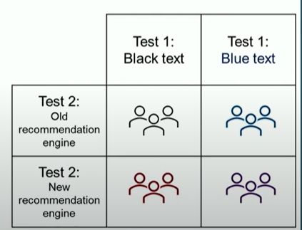
Factorial AB Testing (Factorial Design)
Often a Limiting factor of AB tests is can only run a few concurrent tests OR will take a very long time to get sample size
Factorial design aims to resolve this
allows you to test multiple variations of multiple factors or elements at the same time e.g. change to font, image etc.
Means can expose users to multiple tests simultaneously → allows for huge growth in no. of concurrent tests
can help you save time and resources, increase efficiency and accuracy, and avoid confounding effects. However, a multivariate or factorial design also requires a large sample size, a clear hypothesis, and a careful analysis.

Slide 19
AB Testing Design Tips
Do not run AB test if insufficient traffic → will take too long to achieve statistical significance
Means that a losing treatment model has larger impact on revenue streams
Instead recommend trying a more radical model where likely to see stark difference sin your metric (conversion/lift etc.) so should see results quicker
Recommend starting with one treatment rather than multiple
Impatient SH can lead to A/B/C/D testing. The more variations you test, the higher the chance of FP
Besides, the fewer variants you do, the faster you’ll get results and can iterate
Need some sophistication in your experimental design. If comparing the effectiveness of a model
Do not call A/B tests early!! Wait until have a sufficient sample size
Do not stop exactly when sample size achieved – wait until end of week/month etc. to ensure representative period covered (so that final cycle can be compared against all other cycle measurement periods)
Run tests for full week – as can get day to day variation e.g. higher conversion on weekend vs week start → can skew results
Run test for a couple of business cycles to handle day of week impacts / various traffic sources / external factors like payday / etc.
Consider seasonality & external impacts
Your treatment might be better during Xmas or a PINC period, but not outside of these periods
Maybe a news story or competitor entry could impact each model differently too
Even a 1% lift can be a lot! Do not be disheartened.
1% over 12 one month periods can result in 12% annual lift
12% could be huge if volumes are huge
Also, your site could be performing very well at present anyway, so any incremental gain is good!
Every day without a test is wasted. Should constantly be learning what works and what doesn’t
Make sure you have a large enough sample size for any segment analysis you wish to undertake

Slide 20
Normally would try to split control:treatment 50:50
Try to split control:treatment 50:50 for fastest results (faster better as reduces longitudinal variables too) but may not be possible e.g. SH reluctant
How to compare the (mean) save rate across unequal sample sizes?
Most efficient to run a t-test with equal sample size else power of the t-test is reduced i.e. for a given N (total sample size), power is maximized if split 50:50
Power is based on the smaller of the two sample sizes, so if adding more observations to larger group, then has no effect on power
Analogy - If want to know the area of a rectangle, and the perimeter is fixed, then the area (or power) will be maximized if the length and width are equal (i.e., if the rectangle is a square OR sample size is split 50:50). On the other hand, as the length and width diverge (as the rectangle becomes elongated), the area shrinks.
Why T test can still handle unequal sample sizes? Considers standard error of the estimates of the means for each group. The group with more samples will have smaller standard error than if the population standard deviations are approx equal

Slide 21
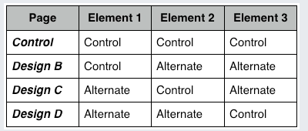
Multivariate Testing
Testing more than one component on the website in a live environment
Is about measuring interaction effects between independent elements to see which combination works best
Running multiple A/B tests on the same page at the same time
Because of the additional variations, this requires more time to achieve a large enough sample size

Slide 22
Sample ratio mismatch (SRM)
Chi-square test. This test will help you to formally check for Sample Ratio Mismatch

Slide 23
What if we cannot just randomly allocate our control / treatment
i.e. user A might already be earmarked for use in a different AB test
Need to ensure that user experiences only one change per interaction
How do we run multiple AB tests concurrently ?
Does one AB test take priority ?
Do we split user traffic to be allocated for each test
Might restrict us from pure random allocation, and need to define some confounding variables
Maybe only trial in a specific geography initially

Slide 24
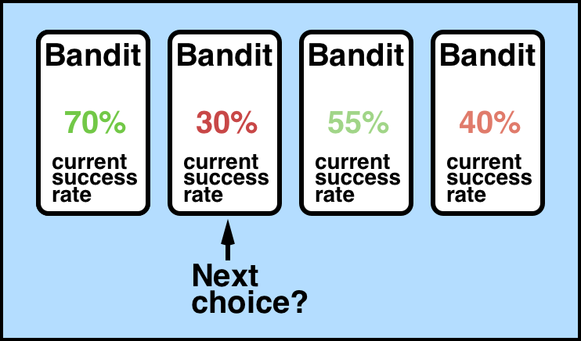
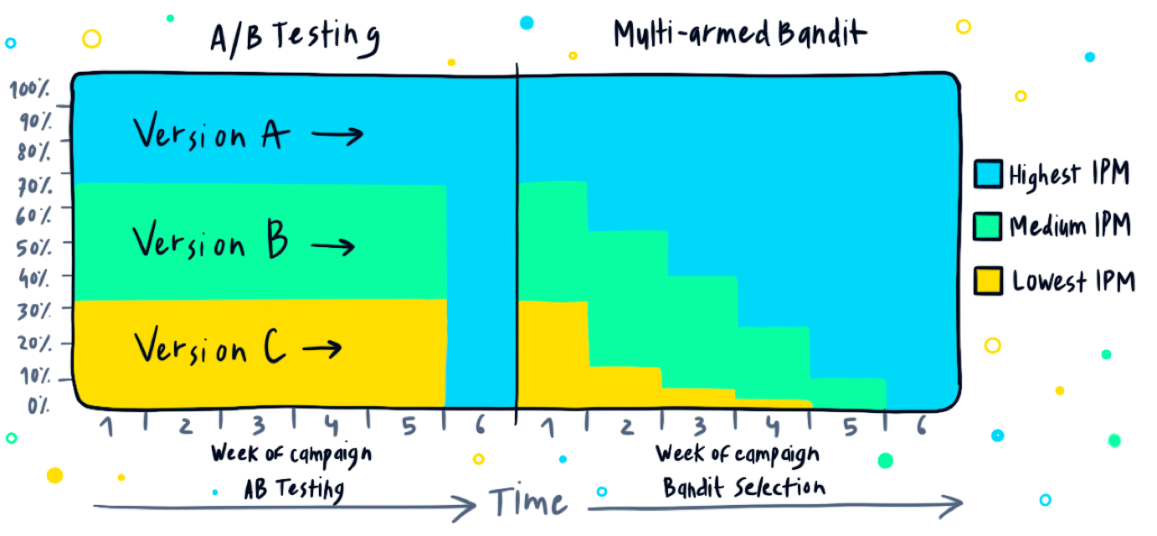
Multi-armed bandit – best where have web users and have high traffic
Idea that even though first bandit has highest success rate with converting customers, this may not be the case tomorrow, so explore another bandit to see if the case. May find that ofc to exploit current knowledge would have been best strategy
Carefully balances exploration vs exploitation – never rest on your laurels idea. Constant AB test on
Useful where high number of choices/actions
Also see https://www.kaggle.com/code/phamvanvung/basics-of-contextual-bandits
Competitor approach to AB testing
Issues with AB include
even if one version far outperforms the other from the get-go, traffic will still be allocated evenly -- with 50% of visitors seeing the underperforming version and the other half directed to the version that is pulling way ahead. Argue waste, if one version clearer better should reallocate to this
Bandit is essentially a policy / choice / action, such as a specific wording of text when card payment failed
Bandit algorithms are a class of algorithms primarily used for website optimisation
What piece of content to recommend
What product to recommend
What phrasing to use to ensure a customer updates their contact details
What
A smarter but more complex approach than AB testing. Finds currently best performing action
Think of a slot machine as a single armed bandit (you pull the arm and gamble your money)
Multi-armed suggests multiple different attempts
SHOULD produce faster results since there is no need to wait for a single winning variation
Example of Contextual MAB
Actions could be ways to max payment success rate
Contextual features could be card_type, n_successful_payments_last1yr, their banks avg payment success, card type etc.
Oracle = domain specific term for the classifier or function containing the clf that maps contexts and actions to the proba payment success. Could be a logistic regression/random forest etc.
Using historical data, the oracle learns to infer the probability of target. Issues with purely relying on this:
Underlying world might change from one moment to another (e.g. bank changes fraud system and suddenly block previously-successful payments)
If model poorly fitted probabilities are wrong
How easy would this scale?
Data Latency issues and how this might impact how quickly algorithm can update policy

Slide 25
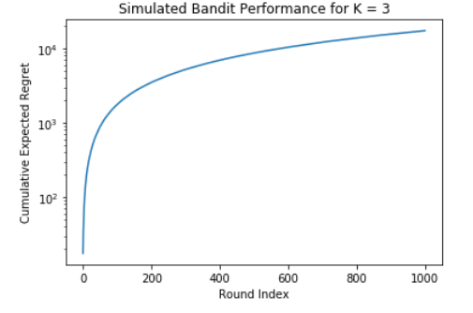
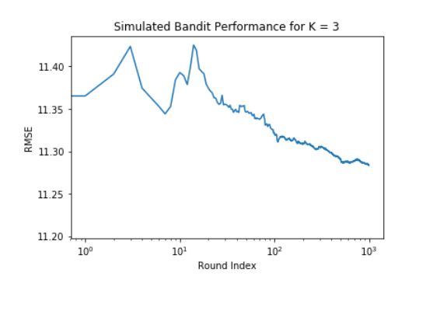
Performance measurement
Aim: try to maximise reward while reducing reward loss when exploring different bandits
We measure reward loss using ‘regret’
Regret = cumulative_reward_{optimal} - cumulative_{rewards}
The lower the regret, the better the model
If regret too high probably should reconsider your action-selection mechanism
Expect that regret gets smaller as able to exploit more data … will never be 0 in a round because world is not static + humans not perfectly predictable
For a single round, regret is what the optimal action reward would be minus the actual action reward (i.e. if use exploration action)
Presume that this trains a model and tries to predict test set for an increasing number of samples to show that with more examples RMSE decreases

Slide 26
CMAB
CMAB different to MAB in that it considers the context of the world too when making a decision
Contextual element factors in customer’s features, or context, when choosing a bandit. The context affects how a reward is associated with each bandit, so as contexts change, the model should learn to adapt its bandit choice E.G. User might be a designer so spends work hours looking to purchase wallpaper etc. but in free time loves knitting so spends evenings looking to buy yarn material etc. model should learn to adapt to know what to recommend to purchase at different times of day
Used for optimisation decisions
ML framework for personalisation + efficient information retrieval + anomaly detection
Learning algorithm should test the different actions and learn which one has most rewarding outcome given the context/state
Will find the best predictor of reward for each state
Goal of agent/learner (i.e. company making the decision to show which optimisation solution be it an ad etc) is to choose actions which maximise cumulative reward after T rounds (reward could be revenue stream or CTR)
At each round, t=1,2,3…T
X = the environment i.e. context
A = action chosen by agent (decision variable)
R = reward provided by the environment given the action (often y in a model)
Task
Produce an algorithm that optimally picks the actions that maximises the cumulative reward by using historical data
N.B. Normally have an explicit feedback loop to test the algorithm but do not here so take this into account
Use Case
Online retailer – when customer enters homepage only room to show 2 personalised products. If they buy, reward to company is price of item, if do not then reward = $0.
Use CMAB to maximise reward where each product is a bandit
See algorithms - Vowpal Wabbit library + UCB1
Cost of switching arms i.e. moving between actions
Finite lifespan of action (might not be able to use a certain tile on NFX as losing rights)
Extension to CMAB is reinforcement learning
Considers effect of sequence of decisions (i.e. allows decisions to affect the world)

Slide 27
Why use CMAB
maximizing cumulative rewards over time by learning an efficient explore vs. exploit policy
Exploit = choosing the bandit (i.e. policy) that maximises the current reward based on its historic success when applied in this context i.e. choose the winning strategy
Can simultaneously learn the effectiveness of different policies rather than wait for a single policy to be evaluated
Context may be very important to the policy chosen (i.e.
When model is certain about the best action, exploit this knowledge to max reward
If model is uncertain we should explore more
Could serve up N ads to customers over long enough period that learn the expected reward for each
Could then allocate ads that max reward
Issue with this is could take ages to learn expected reward, during which time you have incurred the cost of getting it wrong loads of times. Also, by the time you have an estimation, this data may not be as applicable to customers of the future.
Assumption that the distribution of rewards for a given action is not static through time (n.b. where the reward falls within this distribution is dependent on the context i.e. feature input space)
If it was stationary, would make sense to explore initially and then exploit all learnings for ever more, but that isn’t the real world
Need a strategy that can exploit knowledge learned now, but that can explore other actions so you can adapt to emerging trends of the future that carry larger rewards
Not a fully fledged reinforcement learning approach - a kind of hybrid between AB testing & Reinforcement Learning
RL too technically difficult to manage
A low latency ML framework to boost payment conversion rates

Slide 28
Exploitation vs exploration strategy – defining your action selection strategy
Balances exploitation & exploration
The extent of each depends on your action
Exploit
Exploits previous knowledge to maximise current reward i.e. greedy approach
E.G. Show camera enthusiast, camera-related products
Exploration
Explores other rewards because context / real world changes and past is not always good indicator of present
May therefore learn that previous best approach is no longer so and learn next best optimal decision
E.G. Show camera enthusiast, tech related products e.g. wearable tech
Good practice is to exploit more at the beginning, when agent’s information about the environment is less accurate, and gradually adapt this policy as more knowledge is gained
Strategies
Explore-first
Pre-define n examples you wish to explore (i.e. first 1000 customers you just randomly uniformly allocate to one of A actions)
Then use the learnings from these n examples to predict the best action for all subsequent instances
Epsilon greedy
good default
Greedy approach involves just choosing the winning strategy 1-epsilon of the times
1-epsilon – where you define epsilon e.g. 0.1
meaning the prediction of the current learned policy is taken with 90% and with the remaining 10% , an action is chosen uniformly at random
Bagging (bootstrap aggregating) explorer
Define number of bootstrap samples (/intervals/folds) e.g. 5
Assign each example to one of the 5 folds
Train a model on each fold and uniformly picks an action from each fold uniformly at random
This will rule out obviously bad actions, while exploring amongst the plausibly good ones when the variation amongst the m policies is adequate.
Online Cover
Supposedly most sophisticated for CMBA
Like bagggin explorer, except the training of each bootstrap sample is optimised to give a diverse set of predictions, choosing all of the actions that are not already learned to be bad in a given context
I believe other ones include UCB1, Bayesian UCB, and EXP3

Slide 29
AA Testing
Method to verify that control-treatment allocation mechanism works for your AB test before you actually spend/risk money on it
You show two exactly identical pages
Aim is not to discover a lift in conversions, BUT to ensure there is no difference between control and variation versions
When to use
when organizations are implementing a new A/B testing tool
Checking the accuracy of the A/B testing tool being implemented
Setting a baseline conversion rate for future A/B tests
Deciding on a minimum sample size
Organizations who are about to purchase an A/B testing tool or want to switch to a new testing software may run an A/A test to ensure that the new software works fine and has been set up correctly
a good way to run a sanity check before you run an A/B test
check if there is any discrepancy in data, let’s say, between the number of visitors you see in your testing tool and the web analytics tool
in cases where an A/A test provides a winner between two identical variations, there is a problem. The reasons could be any of the following:
The tool has not been set up correctly.
The test hasn’t been conducted correctly.
The testing tool is inefficient.

Slide 30
AA Test - Step By Step (Jupyter Notebook in Google Colab)
Installs & imports packages
Connect to Snowflake (sqlalchemy, snowflake.sqlalchemy)
Defines functions
Return T-test p-value
Final function print_metrics(metric_stats, bucket1=‘treatment’,bucket2=‘control’)
Extracts results from having run the AA test which are stored in Snowflake
Think needs to unhash data using hash function & hash salt
metric_stats is basically a table returned from inline SQL
%%sql metric_stats <<
WITH metrics AS ( ….. Full SQL script that returns table like below, with params )
WHERE dt {{date_range}}
For each metric: considers the mean, variance, and sample size of the treatment, control and other groups
Metric | Treatment Mean | Control Mean | Other Mean | Treatment Variance | Control Variance | Other Vartiance | Treatment Sample Size | Control Sample Size | Other Sample Size
Conversions | 0.6 | 0.61 | 0.58 | 0.1 | 0.1 | 0.09 | 2000 | 2010 | 1995
Clicks
Time on page

Slide 31
Considerations
Run analysis to confirm that the samples are in fact randomly sampled i.e. no selection bias exists and therefore results are valid.
bugs or bias in randomization allocation algorithm can over/under represent certain segments
only difference between test and control has to be the feature we are testing. This implies that test and control user distribution are comparable
Users by region / time of day / day of week / tenure / user type / browser (chrome/edge/safari) / device type → would need to run t-proportion tests on each of these
OR could use features of customers (area, gender, age..) and train a ML model(decision tree easiest to visualise) to be able to predict if user from treatment or control group i.e. use this as our label → should be as good as random if truly random
Could then run a t-test to see if stat significant difference between identified predictive feature
N.B. Also worth ensuring matches non AB tested population
Can depend on choice of test period
If run during holidays or just weekends might impact type of user
It’s not really about testing — it’s about learning
Do not merge multiple ideas into one hypothesis and also limit the variables introduced in the test so that you can understand their individual impact.
Can we find the answer to our business question using exploratory/historical data analysis (e.g. by using causal analysis)?
Might be a seasonal improvement, not an all year round improvement
May have a statistical significant uplift overall, but for certain subpopulations it performs worse
Are there other interacting factors at play e.g. new product launch
Might involve working closely with website designer/software engineers to restrict clickthrough so next activity is clearer and therefore intent easier to analyse. Want a clear cause + effect
Software engineer responsible for randomisation algorithm normally
when the relationship between the independent and dependent variable completely changes/inverts when one takes into account certain spurious variables, this is often referred to by Simpson’s Paradox
Novelty Effect
users might try it out just out of curiosity, even if the feature is not actually better than the controlled/current version
This only impacts returning users. For new users everything is new so this feature cannot have novelty effect by itself
Solutions
# 1 – segment users into new vs old → If the feature is winning for returning users, but not for new users, that’s a really strong sign that novelty effect dynamics are happening.
# 2 - Run tests longer → enough time to get rid of the novelty effect. However, that’s hardly efficient, and the cost of having to run tests for longer would probably outweigh the benefits coming from more reliable results.
change aversion
much smaller problem than Novelty effect as often only happens with major product redesigns (vs small UI tweaks) → which in fact shouldn’t even be A/B tested
segmenting users by new vs returning is always a useful exercise when running an A/B test → healthy A/B test should do well on new users. Else just keep optimizing for old users and end up in a local optimum, not being able to capture opportunities outside of your main user base. → will require Bonferroni correction as running additional test so (ab_test_old.pvalue>0.05/2) → Means need to define min effect size, and sample size for each segment in advance before running the test

Slide 32
Early stopping i.e. P-hacking
May be tempting but don’t stop once see significant result
affects the Internal Validity of the results and makes them biased and it also leads to false positives
Spillover or Network Effects
More common in Social media platforms such as Facebook, Instagram, TikTok
Where users in experimental and control group can interact – so experimental user will use new feature to send messages which will in turn increase responses sent from control user i.e. influence each other’s responses
biases results – violates independence between control and test

Slide 33
Pros | Cons
 | Requires a significant amount of Product, Engineering, and Data Science resources to set this up
 | Might only be a temporary effect before consumers revert back to previous behaviour

Slide 34
Offer Optimisation Framework
Aim: Save more customers at a lower cost. Max CLV??
Simplify to just Cinema / Sports / Kids downgrade calls
Separate model for each downgrade propensity
Current best model vs Contender Model vs Fallow Group (Business Rules)
Have a predictive model for no. calls each week, customer propensity to call, customer offer allocation in each model
Power test to estimate when we have a sufficient sample size to compare
Have to score the customer base as anyone COULD call at any moment
Expected discount = Call Propensity * Offer Allocated
Test
Primary metric in AB test was Expected LTV of customers saved
Primary metric is save rate, secondary metric is cost per save

Slide 35
NOW TV AB TESTING
Are you sure you want to cancel your subscription?
Test 1 : Recommendation tiles for next month
Viewing based algorithm
Test 2 : Different set of Recommendations for next month
Clustering based algorithm

Slide 36
Sky TV Email Enagagement Rate

Slide 37
Multiple Metrics (Experimental Variants) to AB Test
Ideally, you should test no more than three to five metrics or KPIs per A/B test, else risk chance of false positives
Mitigate against this using either Bonferroni correction, Holm-Bonferroni method, or Benjamini-Hochberg procedure
Adjusts significance level or p-value of each metric or KPI based on the number of tests performed, thus reducing the risk of false positives.
can no longer use the same significance level to test for the statistical significance. So, the p-value or the significance level that the results will be compared to needs to be adjusted.
control for Type I error (i.e., alpha or false alarm rate) with the Bonferroni method for correction. It is simply to divide the alpha value (say 0.05) by the number of tests. In the case of three tests, you would end up with a significant level of 0.05/3=0.0167 for each one of your tests. Assuming everything else held constant, this would increase your sample size
Bonferonni Correction to adjust that significance level based on the number of samples n. So, the significance level that needs to be used in multivariate testing should be alpha/N. For example, if the significance level is 5% then the new adjusted significance level should be 0.05/n.
Will likely mean different sample size required to for each test, but choose the largest sample size to ensure can test all applicable

Slide 38
Comparing email subject lines
Subject Line A CTR = 10% vs Subject Line B CTR = 15%

Slide 39
BAYESIAN AB TESTING ?
Might not be poss, think bootstrapping is a poor man’s approach to this

Slide 40
When choosing metric to AB test, consider short-term vs long-term effects, quantity vs quality, and direct vs indirect outcomes

